Slide 1
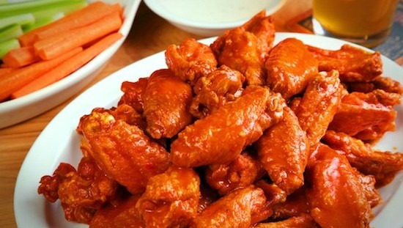
Football 101 L&L
Global Affairs Committee
Are you an international or exchange student,
wanting to learn more about football?
(Or if you never got a chance to get to know the rules of football properly?)
Make socializing this
Super Bowl weekend easier
Friday, Jan 30th
12:15-1:15, Room 1246
Register on Campus Groups
Presented by
Former NFL and College Football Players
Lunch Provided !

