Slide 1
Kellogg Bridging Cultures Club General Interest Meeting
March 31, 2016

Slide 2
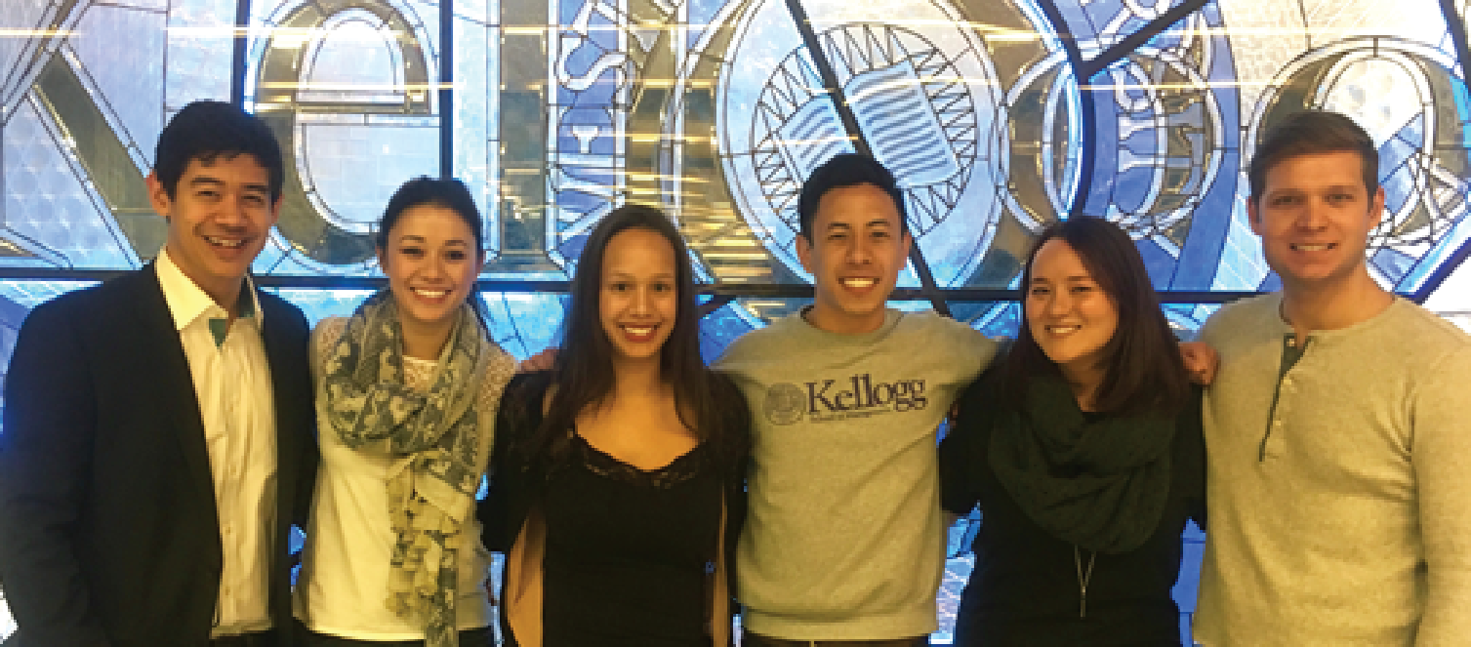
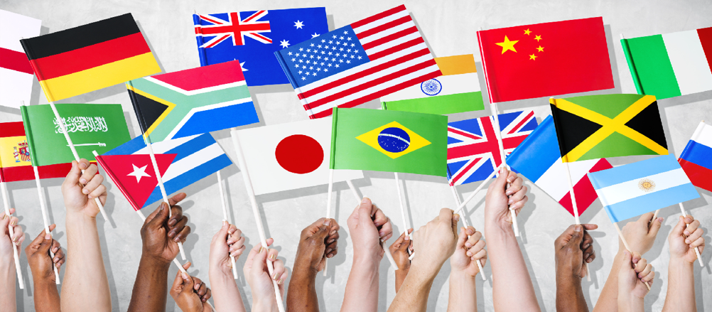
What is the Kellogg Bridging Cultures Club (KBCC)?
In today’s increasingly globalized business world, cross-cultural understanding and experience is becoming ever more essential.
The Kellogg Bridging Cultures Club aims to build a community
to foster strong leaders with cross-cultural backgrounds and experiences.

Slide 3
What are cross-cultural backgrounds and experiences?
Ex-patriots living abroad
Born mixed-race
In a mixed-race relationship
Mixed-faith households
KBCC students are united by the shared experience of being rooted in multiple worlds and possess a unique perspective that is increasingly more essential in today’s world.

Slide 4
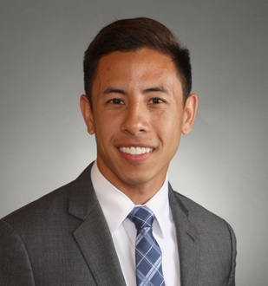
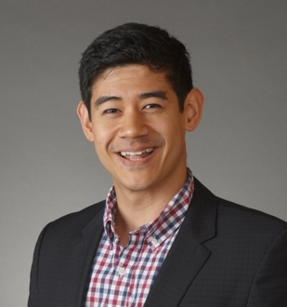
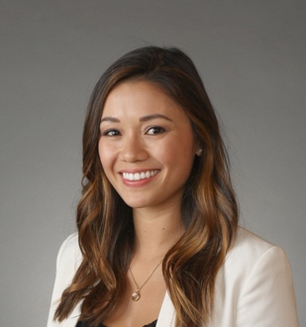
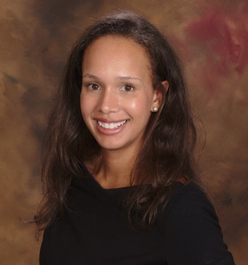
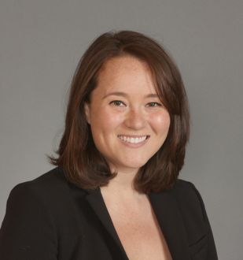
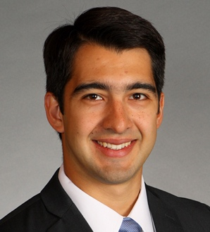
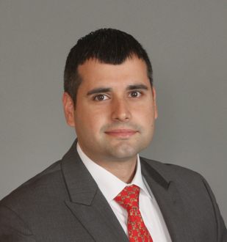
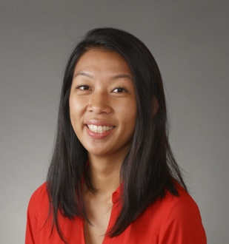
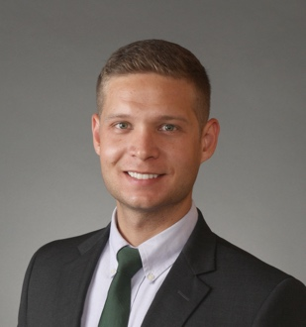
Who we are
CJ Chuapoco
Co-President
James Larsen
Co-President
Lisa Follmuth
Admissions
Alicia Luchetti
Community
Jackie Laine
Mar/Comms
Diego Depetris
SY Advisor
Jose Alves
Programming
Iris Tian
Social
Mathias Jamora
Finance

Slide 5
Upcoming Events
What | When | Description
MOSAIC Week | 4/21/16 12:15 – 1:15PM | The KBCC and MEC are teaming up to discuss Multiracial People and Interracial Relationships in Media
Panel Discussion | TBD | An in-depth panel discussion moderated by Prof. Pearce on the topic of identity and multicultural competency
Deeper Discussion Dinners, Hear My Story, Etc. | TBD | Expanded offerings in upcoming weeks/quarters with KSA

Slide 6
How To Get Involved
Join us on Campus Groups: https://kellogg.campusgroups.com/student_community?club_id=14099
Take on a leadership role with exec
Opportunities to build out External/Corp Relations, Programming, Prof Development
Email cchuapoco2017@kellogg.northwestern.edu and jlarsen2017@kellogg.northwestern.edu
Share your ideas for how we can help YOU
Participate and help educate!

